Slide 1

RETAIL PRICE PREDICTION
Submitted in the partial fulfillment for the award of the degree of
BACHELOR OF ENGINEERING
IN
B.E. CSE (Hons.) with Specialization in Artificial Intelligence and Machine Learning in association with IBM
Submitted by:
VEDANT
20BCS664
Submitted by:
SRI KUMAR DAS
20BCS6629
Under the Supervision of:
MONIKA SHARMA
TANYA GUPTA
20BCS6600
TANUSH SHARMA
20BCS6696
Department of AIT-CSE
DISCOVER . LEARN . EMPOWER

Slide 2
SKYROCKET YOUR SALES
1
Let’s Get Started with Retail Price prediction

Slide 3
ONE-STOP SOLUTION FOR
STRENGTHENING AND SPREADING YOUR BUSINESS are commonly.

Slide 4
INTRODUCTION
Businesses and customers have an interest in predicting the retail
prices of products. In an exceedingly competitive environment, the
worth of a product at a given target outlet is often associated with the
worth of identical or similar products at nearby competing outlets.
This research predicts the beginning of the day and current prices of a
selected product at every outlet in an exceedingly given city using
four-vector autoregression models that incorporate the historical
retail prices of the product at a target outlet and competing outlets.
The models also include the estimated wholesale price of the product.

Slide 5
Accessibility
The model will be accessible through any network connected interface
The model will be platform independent
Owner can input their data and can get the predicted and optimized results

Slide 6
RESEARCHES Mercari Price Suggestion Challenge BY ARUN KUMAR
MERCARI SALES PREDICTION (2020)
is Japan’s biggest community-powered shopping website. With the aim of realizing a society where global resources are used carefully and where everyone can live richly, the company has developed a flea market application ‘Mercari’ in Japan and the United States that allows individuals to easily and safely buy and sell goods.
Existing approaches
18th place solution: The general idea is to train an FM_FTRL model and then a LightGBM model and use an ensemble of both to get the final predictions.
Mercari Golf: 0.3875 CV in 75 LOC, 1900s: an ensemble of 4 MLP models, each model having the same architecture but being trained on apparently 2 different datasets.
TO READ MORE ABOUT THIS RESEARCH :-
https://towardsdatascience.com/mercari-price-suggestion-97ff15840dbd
https://www.kaggle.com/c/mercari-price-suggestion-challenge/discussion/50252

Slide 7
RESEARCH DEMAND FORECASTING AND PRICE PREDICTION BY KJ FERREIRA CITED BY 391 HARVARD
There has been significant research conducted on price-based revenue management over the past few decades; see Ozer and Phillips (2012) and Talluri and Van Ryzin (2005) for an excellent in- ¨ depth overview of such work. The distinguishing features of our work in this field include (i) the development and implementation of a pricing decision support tool for an online retailer offering “flash sales”, including a field experiment that estimates the impact of the tool,
TO READ MORE ABOUT THIS RESEARCH :-
https://www.hbs.edu/ris/Publication%20Files/kris%20Analytics%20for%20an%20Online%20Retailer_6ef5f3e6-48e7-4923-a2d4-607d3a3d943c.pdf

Slide 8
RESEARCHES BLACK TEA PRICE PREDICTION BY MARIA KHADIYUKOVA 1088–1092 (2015) 7 CITATION
Retail price of food products is a complex interplay between multiple factors. Overall product quality has got one of the most serious impacts on the price in many situations. In the present study, an artificial sensory system (potentiometric electronic tongue) was employed for the analysis of black tea samples purchased in the retail stores in Spain and Russia. It was possible to relate the response of a potentiometric sensor system with retail prices of various black tea samples by means of partial least squares (PLS) regression.
PLS regression models are allowed for the prediction of retail price with mean relative errors of about 15 and 25 % for Spain’s tea bags and for loose-packed tea from Russia, respectively. The suggested approach shows a promise for the development of an instrumental analytical technique for regulatory authorities to fight with counterfeits and for commercial purposes to evaluate market space.
TO READ MORE ABOUT THIS RESEARCH :-
Bhattacharyya R, Tudu B, Das SC, Bhattacharyya N, Bandyopadhyay R, Pramanik P (2012) Classification of black tea liquor using cyclic voltammetry. J Food Eng 109:120–126

Slide 9
(i) the creation of a new model and efficient algorithm to set initial prices by solving a multi-product static price optimization that incorporates reference price effects, and (ii) the use of a nonparametric multiproduct demand prediction model. A group of researchers have worked on the development and implementation of pricing decision support tools for retailers. For example, Caro and Gallien (2012) implement a markdown multi-product pricing decision support tool for fast-fashion retailer, Zara; markdown pricing is common in fashion retailing where retailers aim to sell all of their inventory by the end of relatively short product life cycles Smith and Achabal (1998) provide another example of the development and implementation of a markdown pricing decision support tool.
RESEARCH DEMAND FORECASTING AND PRICE PREDICTION BY KJ FERREIRA CITED BY 391 HARVARD

Slide 10
WHAT?
Makes us different
Like above example we aren’t just making a model we will host it on a website or in form of app for greater accessibility

Slide 11
How it will work?
RAW DATA
MODEL
PROFITABLE PRICE PREDICTIONS
A huge amount of data from various sources will be collected as training data
That data will be processed at the backend and appropriate algorithm will be used
User or owner will be able to see the predicted price based upon the inputs

Slide 12
How Our project benefits retailers
To cope with price volatility
Price volatility denotes the price fluctuations of a product. To measure price volatility, you need to take a day-to-day percentage difference in a product or service’s price. price volatility is an essential parameter in price assessment: it shows the level of price uncertainty and allows businesses to predict prices more accurately. The system can analyze and respond to a myriad of factors in fractions of a second, which is something a human never could.
Helps analyze Multiple Sources
Price prediction is hard because it requires many data sources: from internal market reports to competitors’ webpages to CRM files. And it’s a challenge for humans to process this volume of information, whereas, for AI, more data is nearly always better.
12

Slide 13
How Our project benefits retailers
Improves accuracy predictions
The accuracy of traditional pricing methods leaves much to be desired. In truth, most conventional methods value intuition and subjective opinion over hard data .Whereas if you use AI to set your prices, you won’t only work faster and more economically ,you’ll price more accurately
Helps Improve Profit Margin
When you use machine learning, you also get an excellent grasp of how industry prices evolve over the course of a year. And this leads to a final, more subtle benefit. Suppose you spot that a supplier often increases their prices in October. You can make a note to stock up on certain goods in September, avoiding the upcoming increase, saving you money, and boosting your overall profit margin.

Slide 14
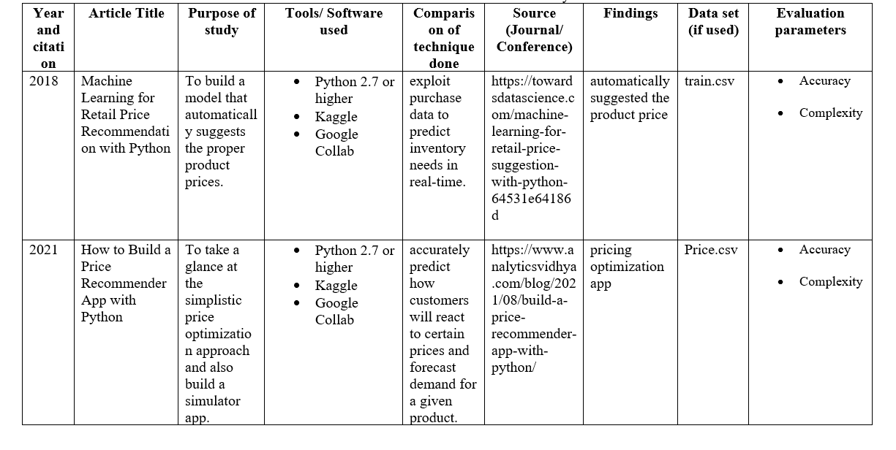
LITERATURE
REVIEW

Slide 15
PROJECT OBJECTIVES
The proposed work is aimed to carry out work leading to the
development of an approach for the Retail Price Prediction Model. The proposed aim will be achieved by dividing the work into the following objectives:
1. Minimizes the risk usually involved in changing prices thanks to its prediction capabilities.
2. Retail teams can essentially use machine learning to test out various promotions or pricing strategies to understand what their impact may be.
3. To make the pricing decisions of pricing managers more profitable.
4. Predict how customers will react to certain prices and forecast demand for a given product.

Slide 16
THANKS!

